Slide 1

Building the MongoDB Environment
Presented by :-
K.Prabhavathi
22H51A05F5
CSE-D

Slide 2
INTRODUCTION :
The MongoDB is an open-source document database and leading NoSQL database.
MongoDB is written in C++.
features :- flexible data models that allows the storage of unstructured data. This provides full support indexing, replication, capabilities and also user friendly APIs.

Slide 3
FUNCTIONALITIES : Mongodb provides following functionality to the database programmers − 1-> Stores user data, comments and metadata. 2-> Mongodb performs complex analytics queries and stores the behavioral data. 3-> This is used to manage chain data and optimize logistics. 4-> Environmental data and iot devices are stored and analyzed.

Slide 4
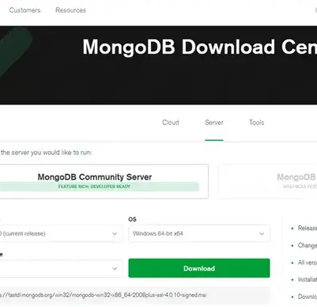
Building Mongodb environment :
Installing MongoDB environment in windows :
visit the link (http://www.mongodb.org/downloads),

Slide 5
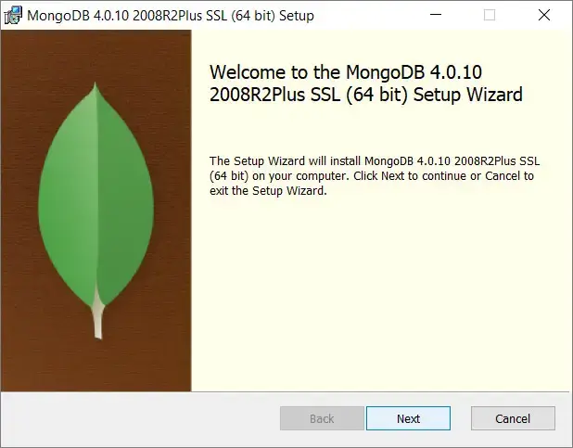
Once the download is complete, double click this setup file to install it. Follow the steps:
Click Next.

Slide 6
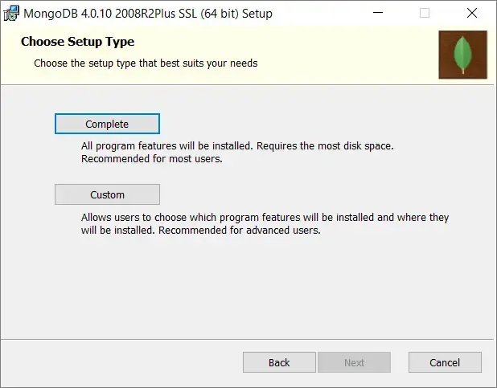
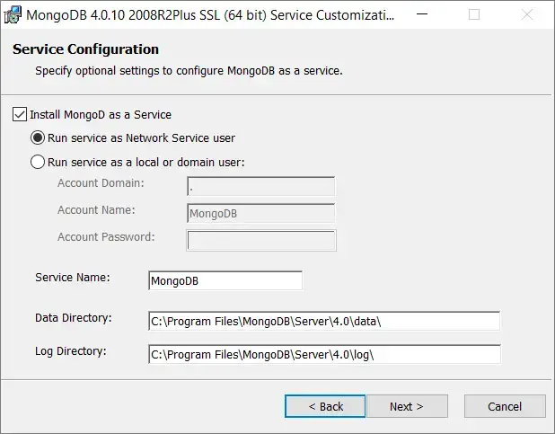
Step 2:-
Now, choose Complete to install MongoDB completely.
Step-3 :-
Then, select the radio button "Run services as Network service user."

Slide 7
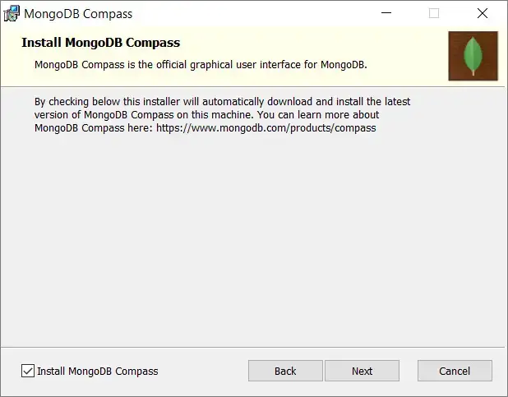
Step-4 :-
The setup system will also prompt you to install MongoDB Compass, which is MongoDB official graphical user interface (GUI). You can tick the checkbox to install that as well.

Slide 8
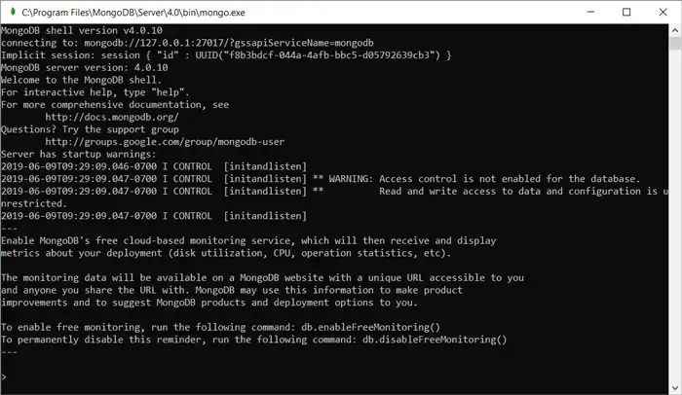
Once the installation is done completely, you need to start MongoDB and to do so follow the process:
Open Command Prompt.
Type: C:\Program Files\MongoDB\Server\4.0\bin
Now type the command simply: mongod to run the server.
In this way, you can start your MongoDB database. Now, for running MongoDB primary client system, you have to use the command:
C:\Program Files\MongoDB\Server\4.0\bin>mongo.exe

Slide 9
Install mongodb in linux :
Add official MongoDB repository to our server:
sudo apt-key adv --keyserver hkp://keyserver.ubuntu.com:80 --recv 0C49F3730359A14518585931BC711F9BA15703C6
Now, you have to create a list file for MongoDB with the use of the command mentioned below:
echo "deb [ arch=amd64,arm64 ] http://repo.mongodb.org/apt/ubuntu xenial/mongodb-org/3.4 multiverse" | sudo tee /etc/apt/sources.list.d/mongodb-org-3.4.list
Now you have to update the repository by executing the command:
sudo apt-get update
Finally, install MongoDB using the command:
sudo apt-get install mongodb-org

Slide 10
ADVANTAGES : DIASDVANTAGES :
Flexibility
Scalability
High Performance
Document-Oriented Storage
Support for ACID Transactions
Rich Query Language
Open Source and Large Community
Integration with Big Data and Cloud
Data Redundancy and Storage Costs
Lack of Joins
Complexity in Handling Complex Queries

Slide 11
APPLICATIONS :
Content Management Systems (CMS)
Real-Time Analytics
Big Data Applications
Internet of Things (IoT)
E-Commerce Platforms
Gaming
Social Networks
Mobile Applications
Personalization Engines

Slide 12
Thank you

